Slide 1

Import Process Overview
Pre-alerts or receipt of scanned copies of clearing documents
Transmit to Agent
Agent Processing (concession, assessment, BOE)
Finance pays Duty
Ship/Airline Release & Other Payments
Delivery, Offloading & Return of Container
IMPEX goes through documents to validate same
Agents sends BOE for Verification
Impex checks BOE and forwards to Finance for payment
Possible area of improvement

Slide 2
Important Information
Pre-alerts or receipt of scanned copies of clearing documents: Prior to every clearing process, documents are received from suppliers. Depending on the order, some of the most critical documents needed are:
Bill of Lading (for sea shipments) / Air Waybill (for air shipments) / Delivery Note (for road shipments)
Final / Commercial Invoice
Packing List
Certificate of Origin
Customs Declaration (or BOE) is generated in ICUMS after the agent inputs details are per required fields using the documents above (BL/AWB/DN, Invoice, PL & COO)
The draft BOE is then sent to IMPEX for checks and validation. In checking:
Check Shipper, Consignee using BL/AWB/DN
Check Weights on PL
Check HS Code using COO
Check Freight Amount on Invoice (depending on the incoterm: CFR – Cost & Freight, in which case, the invoice should have a freight value stated; CIF – Costs, Insurance and Freight, in which case, the invoice should have values for insurance and freight stated; FCA/FOB – Free Carrier / Free on Board, in which case, there’s no need for a freight value quoted on the invoice)
Section 21 tells you the mode of shipment (e.g., if ‘Entry/Exit’ reads KIA, then consider as air shipment and look out for an AWB; if TMA, consider as sea and look out for a BL)

Slide 3
Key Information 2
Mostly, the description of goods in section 25 gives an idea whether the HS/Commodity Code used is right or not. You may double check the HS code using the CET File attached as part of documents needed for validation
NB: For CIF shipments, FOB + Insurance + Freight = Total Invoice Value (all in one currency). Currency rate is usually in section 16 to guide
Customs value is calculated on the incoterm (e.g., CIF, FOB, etc.)
For shipments with code 40E68, we pay for Import VAT in full. Also, Amount Payable = Rate (5%) * Customs Value
For 40V02, VAT is exempted for payment later and there is no concession amount. So, Amount Payable = 0.00, Amount Exempted = VAT Rate * Customs Value
For 40U01 & 40W01, Import Duty is exempted.
40W01, Import Duty is exempted, however, we pay taxes.
HS Code can be confirmed in the CET File (column C ‘Description’ and column E ‘ID’). Column E has rates (in %) which are reflected on the BOE in section 40 (Rate column).

Slide 4
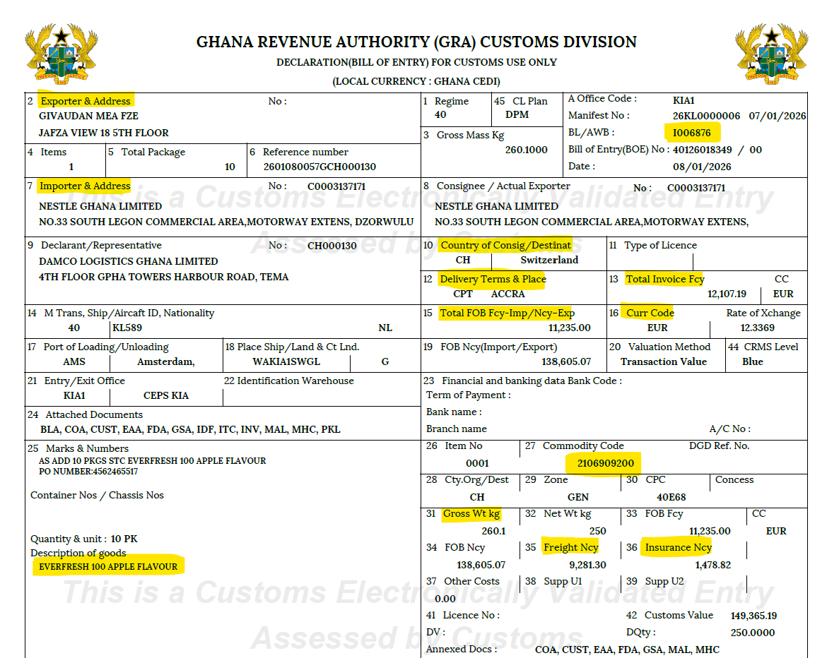

Slide 5
